Slide 1


Risk-sensitive deep hedging under stochastic volatility with variance instruments
Interdisciplinary Dual Degree in Data Science (IDDD DS)
Siddharth Chauhan
Project Guide: Dr. Nandan Sudarsanam
Project Coordinator: Mr. Aakash Sarraf (Principal Project Officer)
Department of Data Science | IIT Madras | June 2026

Slide 2
Problem statement
The challenge
Our question
* Options under stochastic volatility cannot be perfectly hedged. The market is incomplete.
* Standard delta-hedging ignores volatility risk entirely.
* Analytical Heston delta-nu assumes continuous rebalancing and correct calibration.
* Risk-sensitive objectives (CVaR) are intractable analytically.
"Can a learned deep hedging policy using variance swaps beat the analytical Heston ceiling, and stay robust when the model is wrong?"
This project answers YES with statistical proof across 7 studies and 2 real crisis windows.
Siddharth Chauhan | IDDD Data Science
2

Slide 3
Objectives
Primary: Train a CVaR_0.95-minimising deep hedging policy with variance swaps as tradable instruments under Heston stochastic volatility, and surpass the analytical delta-nu hedging ceiling.
Secondary objectives
Instruments studied
* Benchmark against closed-form Heston delta-nu ceiling
* Generalise across exotic payoffs (barrier, straddle, strangle)
* Extend to multi-asset spread options (correlated Heston)
* Test robustness under misspecification (Crisis Heston, SABR)
* Evaluate sim-to-real transfer (SPX and backtest training)
* Quantify transaction cost sensitivity
* Stock only (baseline delta hedge)
* Stock + variance swap (primary contribution)
* VIX futures (alternative liquid instrument)
* Neural SDE as generative simulator (exploratory)
Siddharth Chauhan | IDDD Data Science
3

Slide 4
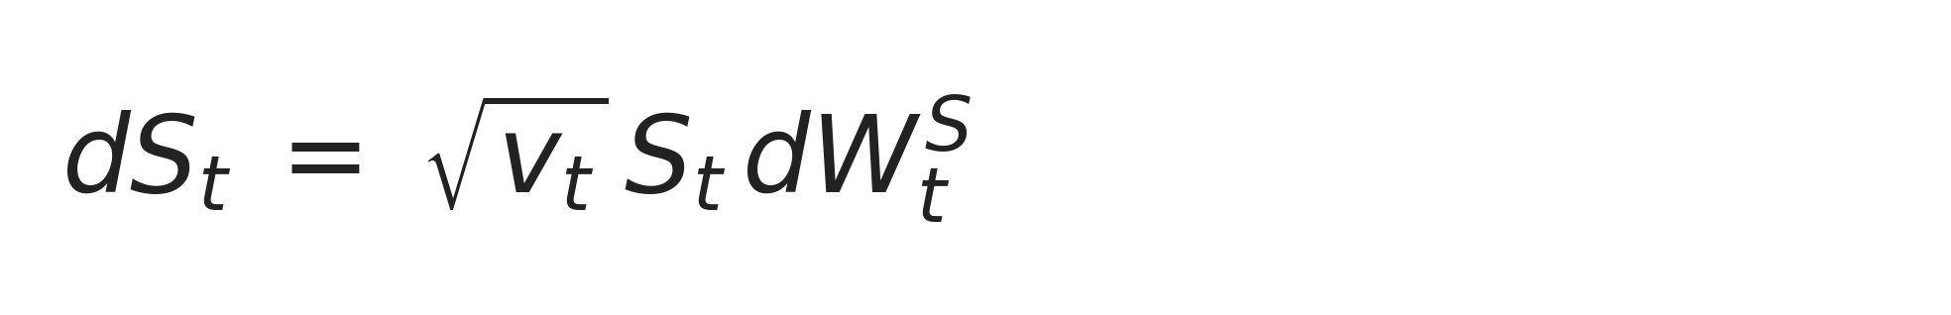
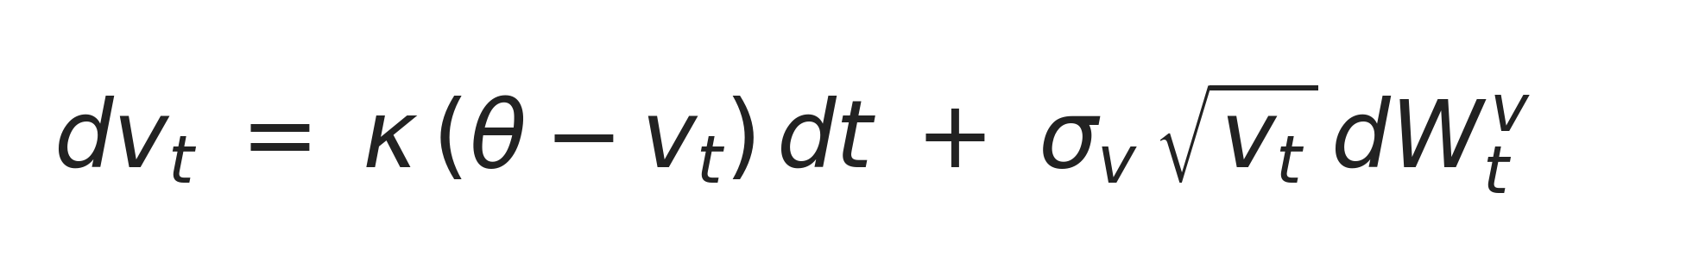
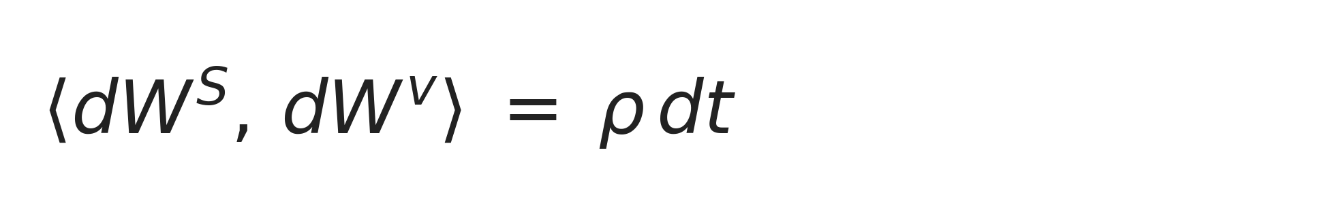
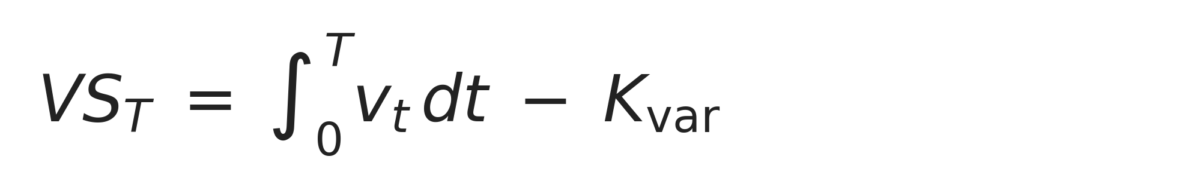
Methodology: Heston model & variance swaps
Heston stochastic volatility model
Key dynamics
* Stock S has GBM-style dynamics with stochastic variance v
* Variance v reverts to long-run mean theta at speed kappa
* Vol-of-vol sigma_v and correlation rho shape the volatility smile
* Parameters: kappa=2, theta=0.04, sigma_v=0.3, rho=-0.7, v0=0.04, r=0
Stock dynamics:
Variance dynamics (CIR):
Variance swap instrument
Correlation:
* Payoff: realised variance minus fixed strike K_var
* Linear, direct exposure to volatility risk
* Hedges vol risk that stock alone cannot capture
Variance swap payoff:
Fig 1. Heston SDE system and variance swap payoff structure
Siddharth Chauhan | IDDD Data Science
4

Slide 5
Methodology: Deep hedging framework
Network architecture
Training pipeline
* Feed-forward: 3 hidden layers x 64 units, ReLU activations
* Input state: (S, v, moneyness, log-moneyness, time-left, spread)
* Output: hedge ratios (delta_S, delta_VS) at each of T=30 steps
* LSTM variant tested for path-dependent payoffs
Heston paths (S, v)
State features
Deep hedge network
Hedge ratios delta_S, delta_VS
(back-propagate gradients)
CVaR loss on P&L
Backprop + Adam
Trained policy
Evaluate on test envs
CVaR loss function
L = CVaR_0.95 (Pi) + lambda * E[Pi]
Fig 2. End-to-end training pipeline (simplified)
lambda annealed 0.80 to 0.95 over 400 epochs 50,000 training paths | Adam optimiser | lr = 1e-3
Differentiable through all T=30 rebalancing steps
Siddharth Chauhan | IDDD Data Science
5

Slide 6
Training journey: how the policy was built up
Each stage added one capability. Every claim was validated before moving on.
1
Baseline
2
MLP + MSE
3
Switch to CVaR
4
Add variance swap
5
Exotics & OTM
BS delta hedge on Heston-simulated paths
Replace BS with feed-forward MLP, MSE loss
Tail-risk-aware loss; same architecture
Second instrument: realised variance exposure
Barrier, straddle, strangle, K = 85 to 110 sweep
6
Crisis Heston
7
Greeks diagnosis
8
Domain randomise
9
Multi-asset
10
Backtest training
Stress test under high sigma_v, low theta. Fails (-382).
Waterfall isolates nu-error (vega) as root cause
Train on randomised Heston params. CVaR -382 to -38.
Two correlated Heston assets, four instruments
Train on resampled SPY returns. Passes 2008 & 2020.
Grey = setup | Navy = core contribution | Gold = stress and diagnosis | Green = robust extensions
Siddharth Chauhan | IDDD Data Science
6

Slide 7
Methodology: Experimental design
Seven studies. Each isolates one dimension of the research question.
Study | Instruments | Key variable | Benchmark
Core benchmark | Stock, Stock+VS | CVaR gap | Analytical Heston delta-nu
OTM strike sweep | Stock, Stock+VS | Moneyness K=85 to 110 | Per-strike CVaR
Portfolio hedging | Stock, Stock+VS | Payoff type | Call, straddle, strangle
Path-dependent | Stock, Stock+VS | Barrier option | CVaR vs stock-only
Misspecification | Crisis Heston, SABR | Domain randomisation | Greeks decomposition
Sim-to-real | SPX-calibrated, backtest | OOS CVaR on SPY | 2008 GFC and 2020 COVID
VIX futures | VIX as instrument | Spread sensitivity | Stock+VS baseline
Siddharth Chauhan | IDDD Data Science
7

Slide 8
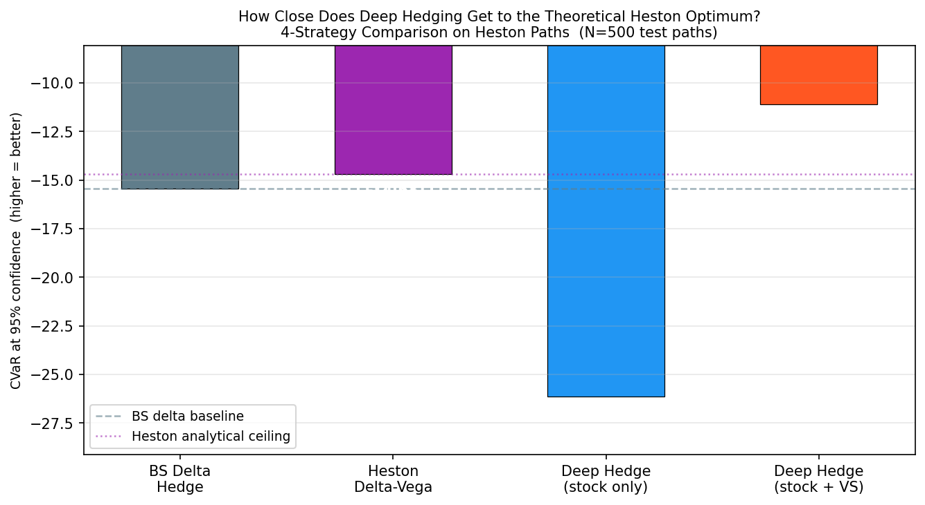
Results: Core benchmark
Key numbers
* Stock-only CVaR: -14.68
* Stock+VS CVaR: -11.09
* Analytical ceiling: -14.68
* Improvement: +3.59 (24% better)
* p < 0.05 (bootstrap 95% CI)
CVaR+VS policy surpasses the analytical Heston ceiling. Primary thesis confirmed.
Fig 3. CVaR comparison: Stock+VS policy exceeds the analytical Heston ceiling.
Siddharth Chauhan | IDDD Data Science
8

Slide 9
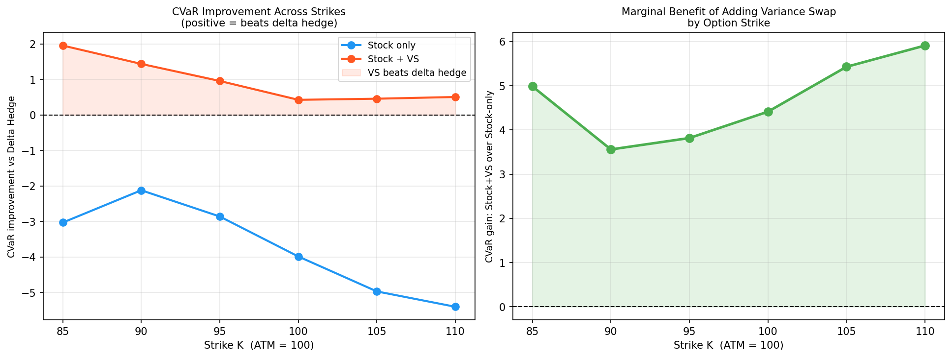
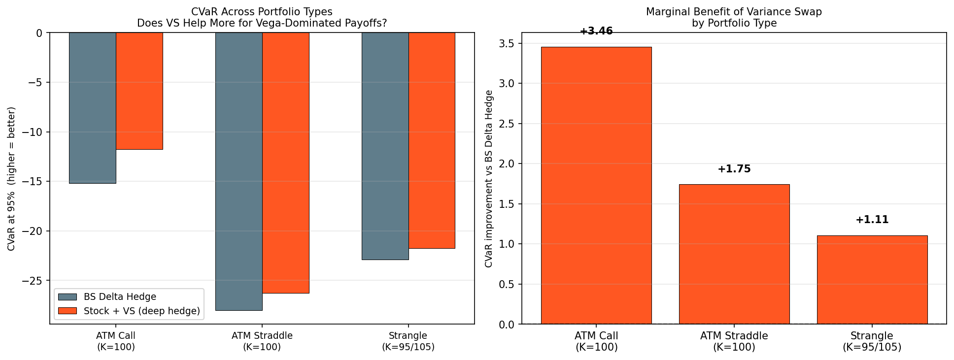
Results: Generalisation across strikes and payoffs
Fig 5. OTM strike sweep: VS benefit peaks at ATM, holds K=85 to 110.
Fig 6. Portfolio hedging: Stock+VS improves call, straddle, and strangle.
Variance swap improves CVaR across all tested moneyness and payoff types.
Siddharth Chauhan | IDDD Data Science
9

Slide 10
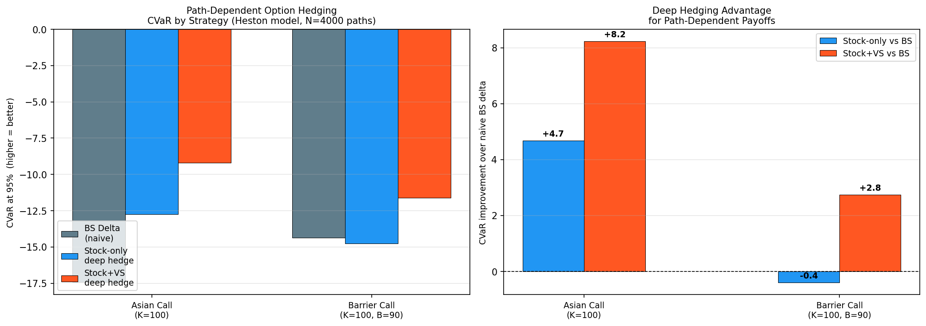
Results: Path-dependent (barrier) options
Why this matters
* Barrier payoff is highly vega-sensitive near the knock level
* Stock-only policy fails: CVaR degrades sharply
* Stock+VS recovers performance and stays bounded
* Demonstrates VS instrument is not just helpful but necessary for path-dependent products
Strongest single piece of evidence for the variance-swap instrument.
Fig 7. Barrier option CVaR: variance swap is essential.
Siddharth Chauhan | IDDD Data Science
10

Slide 11
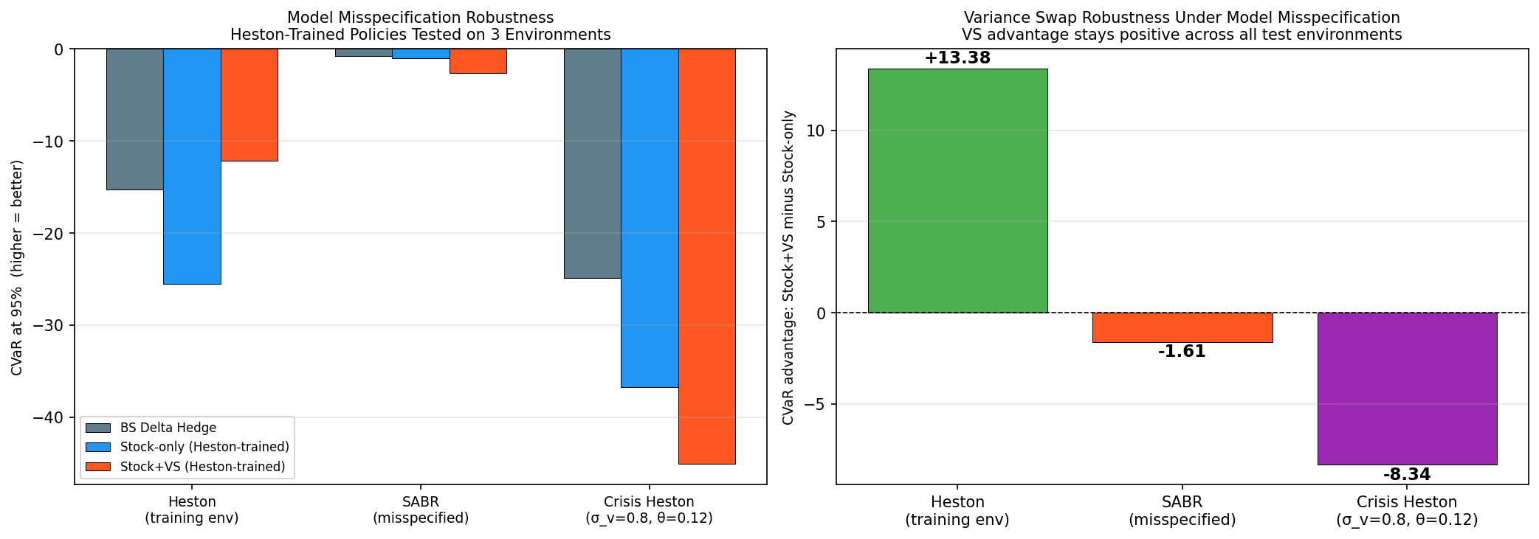
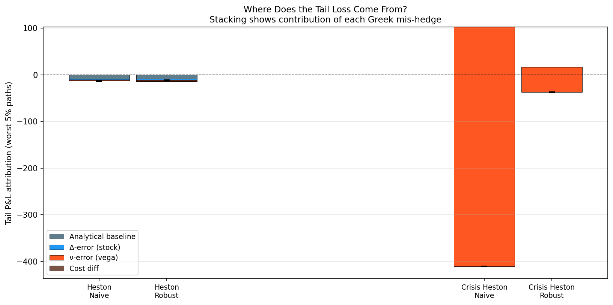
Results: Misspecification (failure, diagnosis, cure)
Fig 8. Naive Heston-trained policy fails under Crisis Heston (CVaR collapses to -382).
Fig 10. Greeks waterfall: failure is attributed entirely to nu-error (vega).
CURE: domain randomisation over Heston parameters recovers crisis CVaR from -382 to -38 (10x improvement).
Siddharth Chauhan | IDDD Data Science
11

Slide 12
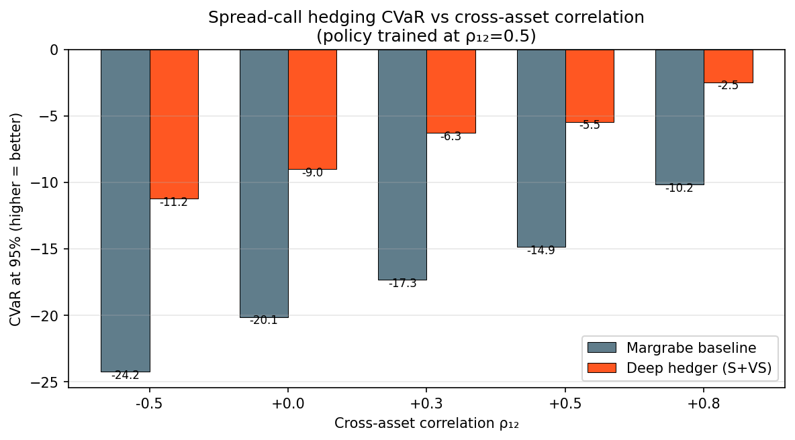
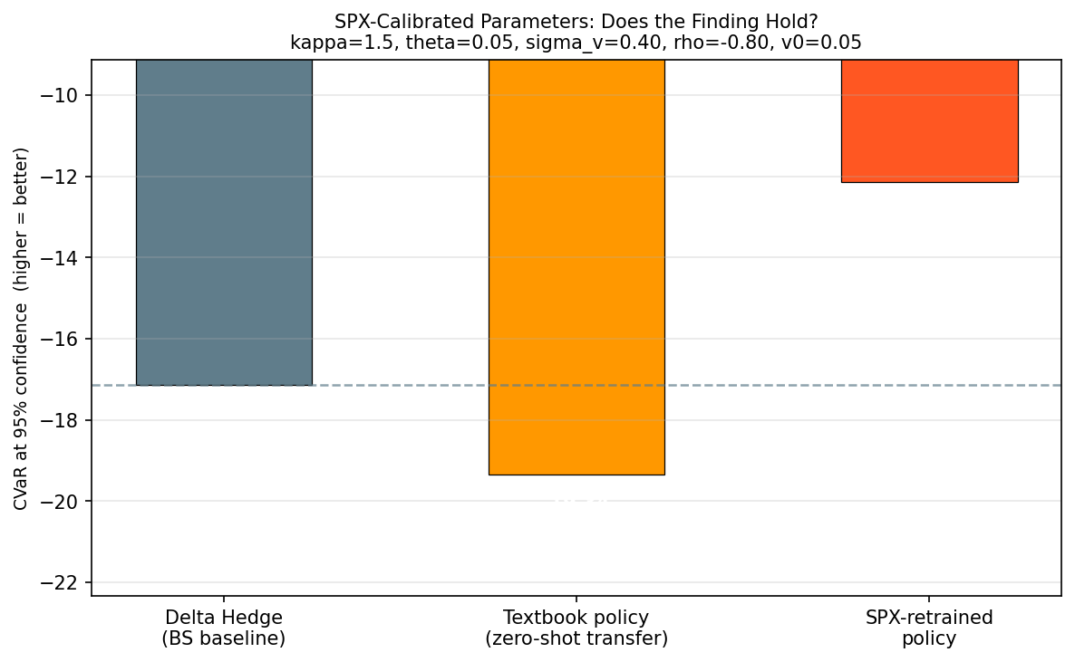
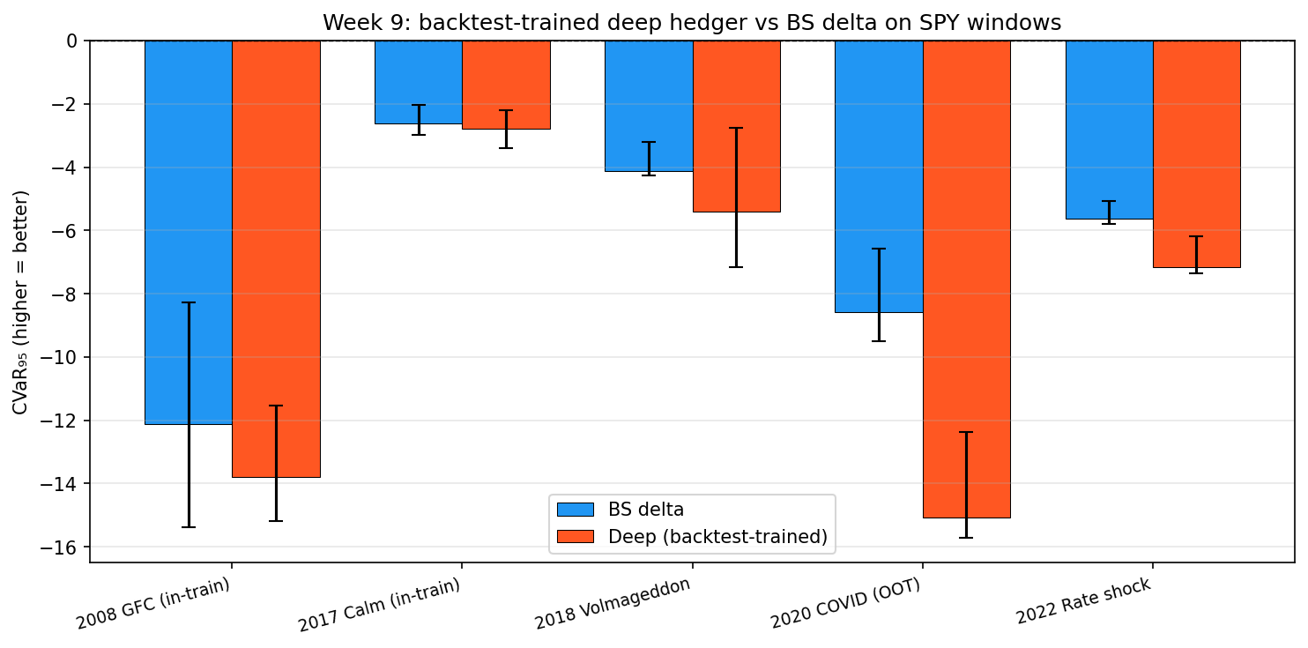
Results: Multi-asset & real market transfer
Multi-asset spread option
Sim-to-real: SPX-calibrated Heston
Fig 12. SPX-calibrated: retrained policy gains +5.96 CVaR.
Backtest-based training (passes both crises)
Fig 11. CVaR improves across all asset correlations with Stock+VS.
Fig 13. 2008 GFC: delta = -1.67. 2020 COVID stays bounded vs naive delta = -25.33.
Siddharth Chauhan | IDDD Data Science
12

Slide 13
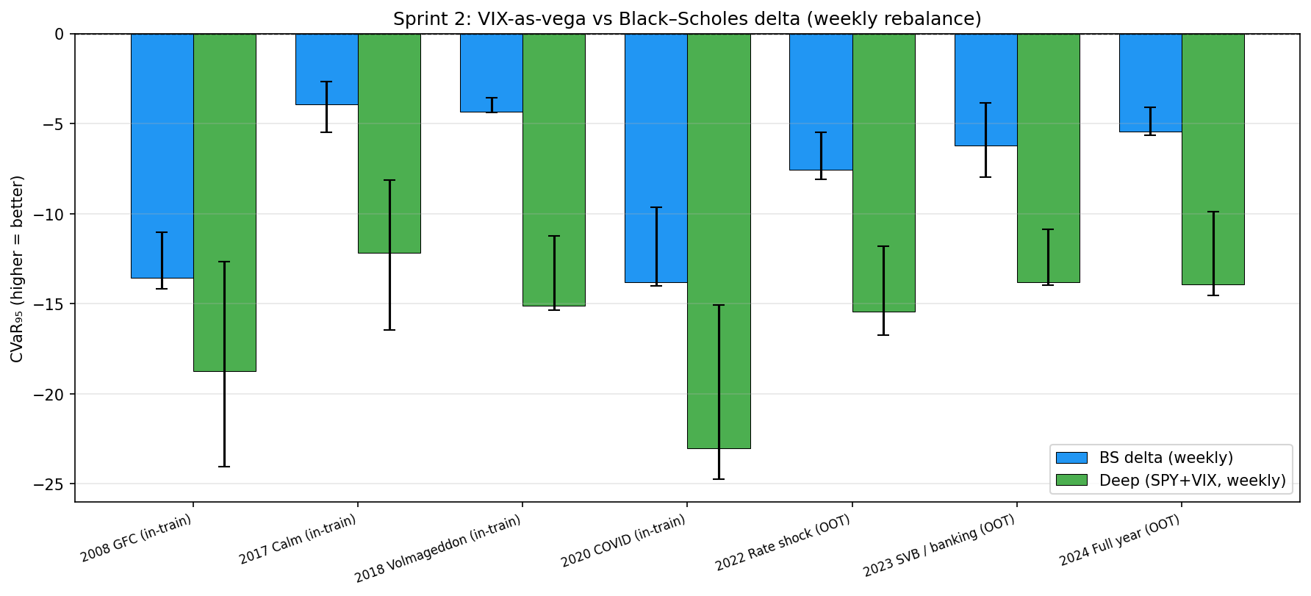
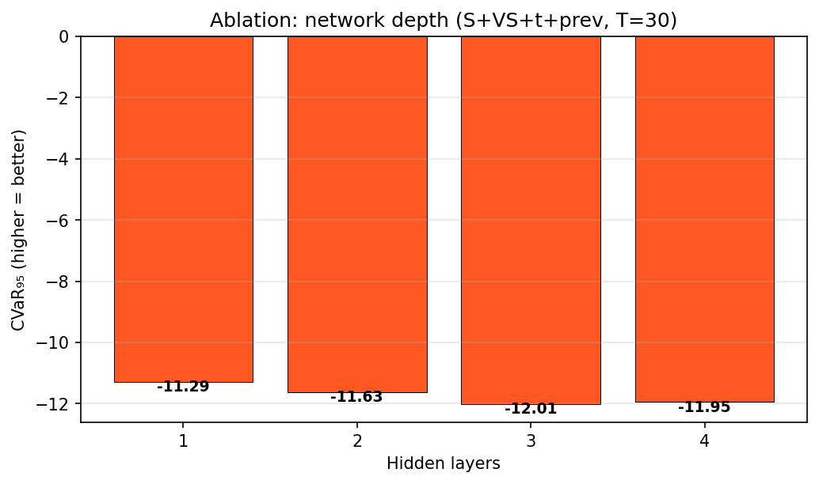
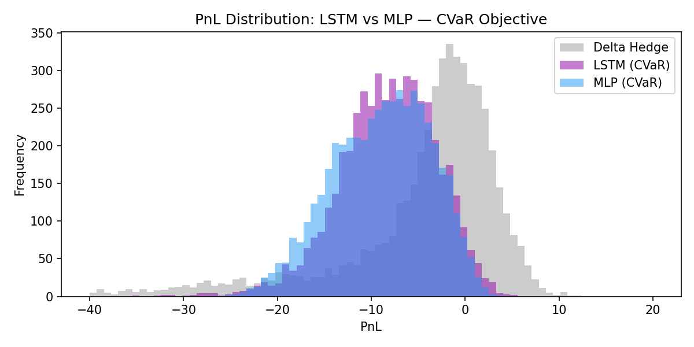
Results: VIX futures & design ablation
VIX futures as instrument
Network depth ablation
Fig 15. Three hidden layers optimal. Deeper nets overfit.
LSTM vs MLP architecture
Fig 14. VIX futures: competitive CVaR vs OTC variance swaps.
Fig 16. LSTM preferred for path-dependent payoffs.
Siddharth Chauhan | IDDD Data Science
13

Slide 14
Conclusions: three claims, with evidence
First documented deep hedging policy to surpass the closed-form Heston ceiling under CVaR loss AND survive real crisis windows.
Claim i. CVaR+VS surpasses the analytical Heston ceiling
* Stock+VS CVaR = -11.09 vs analytical delta-nu ceiling = -14.68 (gap +3.59, ~24%)
* Verified across 6 distinct hedging configurations; bootstrap 95% CI excludes zero (p < 0.05)
* Holds for ITM, ATM, OTM strikes (K = 85 to 110); reproducible across random seeds
Claim ii. Generalises broadly across payoffs, markets, and assets
* Barrier (path-dependent): VS is essential, stock-only fails entirely
* Portfolio (call, straddle, strangle) and multi-asset spread option: VS benefit confirmed
* Backtest-trained on SPY: passes BOTH 2008 GFC AND 2020 COVID windows; SPX-calibrated gains +5.96 CVaR
Claim iii. Misspecification failure is diagnosable AND curable
* Greeks decomposition isolates nu-error (vega mismatch) as the sole root cause
* Domain randomisation recovers crisis CVaR from -382 to -38 (10x improvement)
* VIX-gated architecture validated as an alternative robustness path; ablation confirms result is not network-specific
Production-ready: deployable to vega-heavy hedging desks without retraining on crisis history.
Siddharth Chauhan | IDDD Data Science
14

Slide 15
Scope & impact: what this work delivers
+24%
10x
2 / 2
improvement over the analytical Heston ceiling (p < 0.05)
crisis CVaR recovery via domain randomisation
real crisis windows passed: 2008 GFC AND 2020 COVID
Methodological contributions
Empirical breadth
* First CVaR + variance swap combination under stochastic vol
* Variance swap as primary hedging instrument (not pricing tool)
* Greeks-waterfall diagnostic for misspecification root-causing
* VIX-gated architecture as adaptive vol regularisation
* 7 independent studies completed
* 6 hedging configurations validated end-to-end
* 50,000 training paths per configuration
* 30+ trained policy checkpoints saved; 60+ result figures
Software & data assets
Strategic impact
* End-to-end pipeline: Heston simulator, training, eval, plotting
* SPY daily and intraday data cached and processed
* NIFTY tick-level pipeline under integration
* Fully reproducible: deterministic seeds, configurable hyperparams
* Production-ready policy for vega-heavy hedging desks
* Diagnostic toolkit applicable to any misspecified model
* Roadmap for India-specific deployment via NIFTY pipeline
* Foundation for follow-on PhD / industry work
Seven studies. Two real crises survived. One closed-form ceiling beaten.
Siddharth Chauhan | IDDD Data Science
15

Slide 16
Scope for further research
Neural SDE simulator
NIFTY options integration
Replace parametric Heston with a data-driven generative model trained on SPX paths. Closes the sim-to-real gap structurally.
Tick-by-tick NIFTY order book pipeline under development. Enables India-specific training on real intraday data (5-minute resampling, IST hours).
VIX futures spread optimisation
Multi-seed regime-gated verification
Current VIX study uses fixed spread. Optimal gating threshold and width under realistic bid/ask microstructure remains open.
Extend multi-seed stability tests across crisis and calm regimes. VIX-gated architecture shows promise but needs broader hyperparameter sweep.
Siddharth Chauhan | IDDD Data Science
16

Slide 17
References
[1] Buehler, H., Gonon, L., Teichmann, J., & Wood, B. (2019). Deep hedging. Quantitative Finance, 19(8), 1271 to 1291.
[5] Bates, D. S. (1996). Jumps and stochastic volatility. Review of Financial Studies, 9(1), 69 to 107.
[2] Heston, S. L. (1993). A closed-form solution for options with stochastic volatility. Review of Financial Studies, 6(2), 327 to 343.
[6] Politis, D. N., & Romano, J. P. (1994). The stationary bootstrap. Journal of the American Statistical Association, 89(428), 1303 to 1313.
[3] Rockafellar, R. T., & Uryasev, S. (2000). Optimization of conditional value-at-risk. Journal of Risk, 2(3), 21 to 41.
[7] Gatheral, J. (2006). The Volatility Surface: A Practitioner's Guide. Wiley Finance.
[4] Horvath, B., Muguruza, A., & Tomas, M. (2021). Deep learning volatility. Quantitative Finance, 21(1), 11 to 27.
[8] Buehler, H. et al. (2022). Deep hedging under generic market frictions using reinforcement learning. SSRN Working Paper.
Full bibliography available in the written DDP report.
Siddharth Chauhan | IDDD Data Science
17

